Slide 1
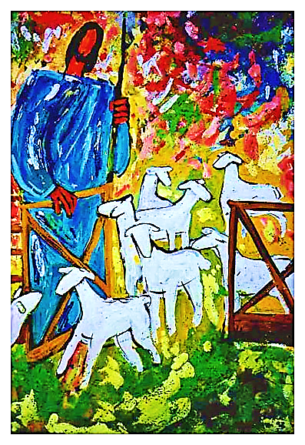
The Good Shepherd
pt. 2 (The Door)

Slide 2
Note: Any videos in this presentation will only play online. After you download the slideshow, you will need to also download the videos from YouTube & add them back into your PowerPoint.
We present these messages at outdoor events around Texas. If you would like to watch the video of the service with this message, click here:
http://campaignkerusso.org/?p=11024
We would love to know more about the people who download our lessons & sermons. We invite you to email us & let us know where & how you use them.
info@ckbrazos.org

Slide 3
Welcome All

Slide 4
Let’s Begin with Prayer

Slide 5
The Good Shepherd
pt. 2 (The Door)

Slide 6
This Slide – Song: Savior, Like a Shepherd Download Here:
https://youtu.be/UPlIlkLFt_A

Slide 7
This Slide - Video: What Kind of Door Would Best Help Tinkerbelle? → Download Here: http://www.youtube.com/watch?v=T15dTC1h57A

Slide 8
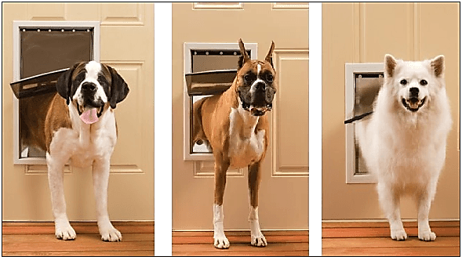
Some doors are just right for dogs…
but that didn’t help Tinkerbell.

Slide 9
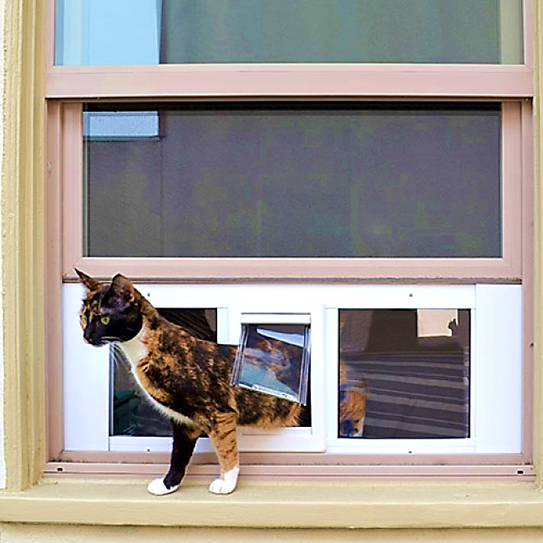
Some doors are just right for cats…
but that didn’t help Tinkerbell.

Slide 10
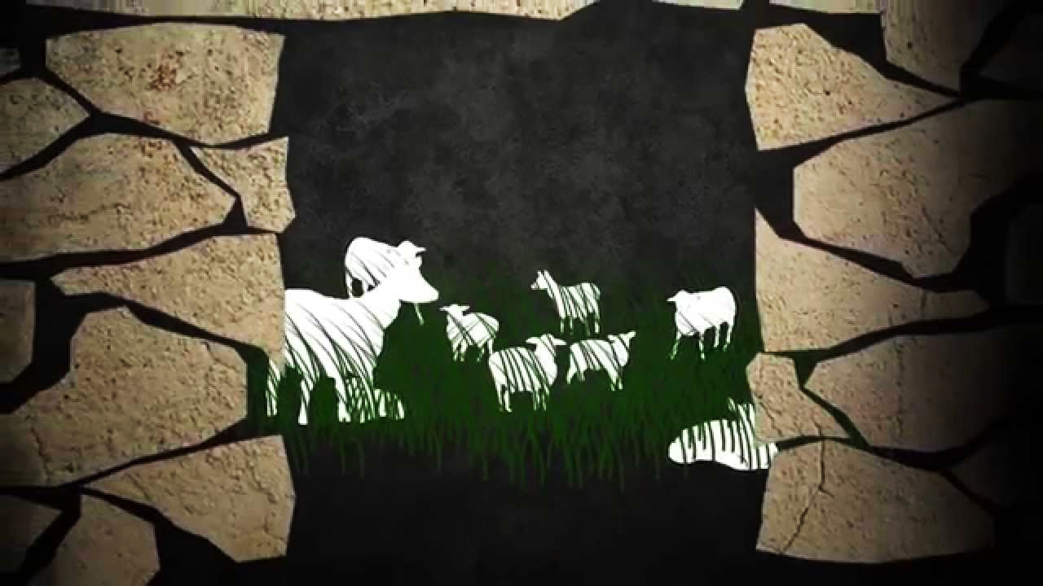
Tinkerbell needs a
door made for sheep.

Slide 11
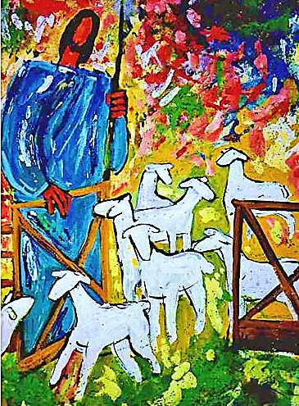
Jesus says:
“I Am the Door of the Sheep” John 10:7
“…We are His people and the sheep of His pasture.”
Psalm 100:3

Slide 12
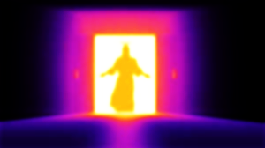
Why does Jesus call Himself the Door?

Slide 13
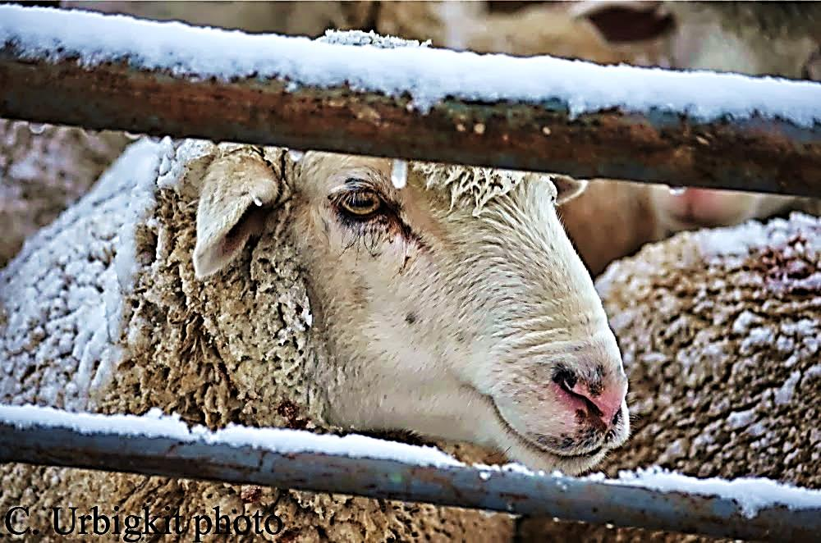
This is called a SHEEPFOLD. Here, the sheep are protected.
Shepherds put their flock in a safe fenced area.

Slide 14
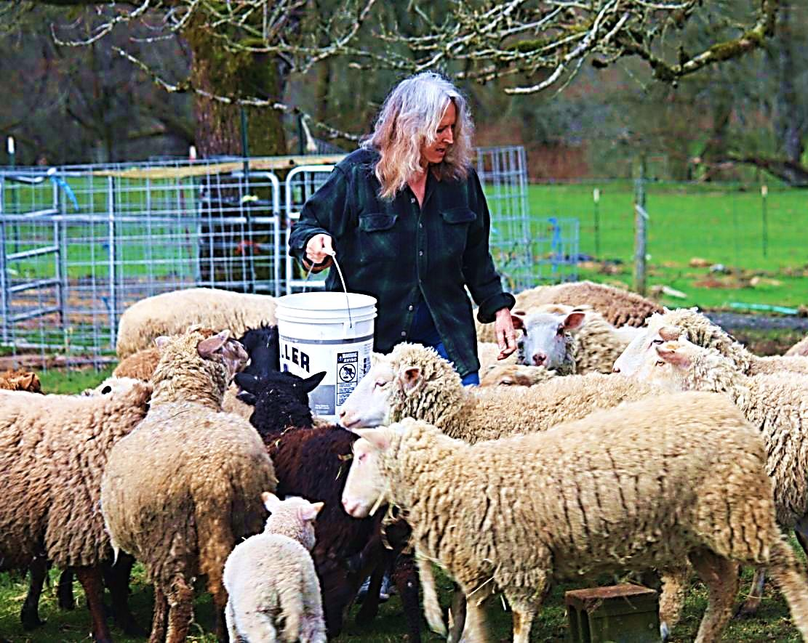
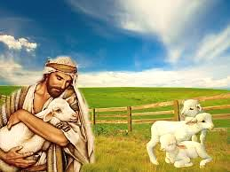
This sheep pen is their home, where the sheep are loved and well fed.
But, there was only one door into the sheepfold’s of old.

Slide 15
A Human Door

Slide 16
This Slide: Song - “I Am the Door” Download Here: http://youtu.be/iQq5OlTnlSE

Slide 17
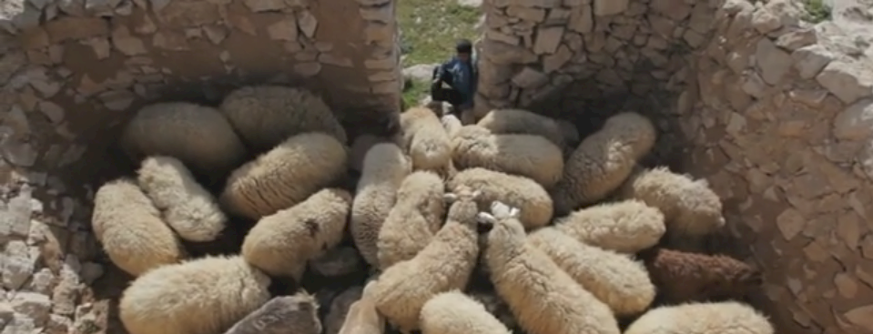
The Shepherd guards the entrance to the pen.
His body is the Only DOOR!
Shepherds would become human doors for their sheep.

Slide 18
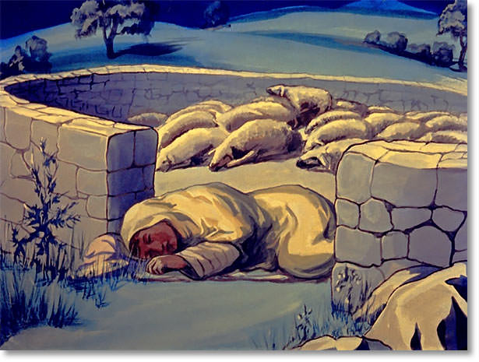
I am the door. If anyone enters through Me, he will be saved. Jn. 10:9

Slide 19
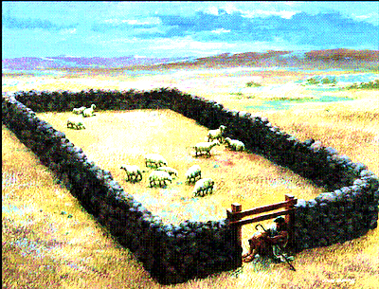
Jesus answered, “I am the way, the truth, and the life. The only way to the Father is through me. Jn. 14:6

Slide 20
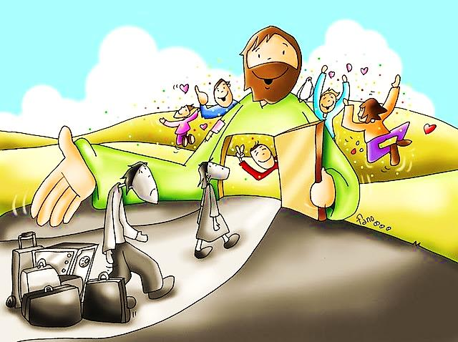
We are His sheep and He is the door into His pasture.

Slide 21
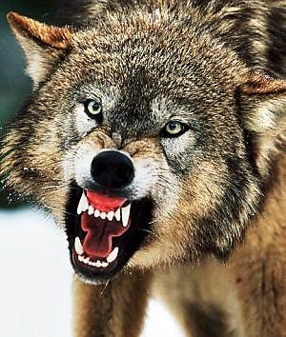
The sheep in the sheepfold are safe from wolves & anything that might harm them.
Good shepherds stand watch & would even die for their sheep.

Slide 22
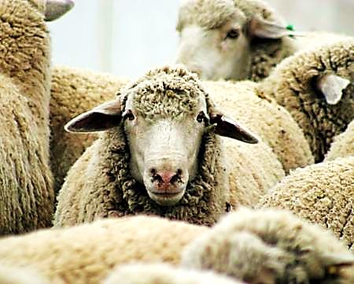
“’…We are his people. WE ARE the SHEEP belonging to his flock.” Psalm 100:3
He Died for Us

Slide 24
This Slide – Song: The Good Shepherd Download Here:
https://youtu.be/83BOqJ1kIZY

Slide 25
Is Jesus
Speaking to You?
“They said to each other, ‘Did not our hearts burn within us while he talked to us on the road, while he opened to us the Scriptures?’”
John Wesley Said:
“…the preacher was describing the change which God works in the heart through faith in Christ and I felt my heart strangely warmed.”
Jesus makes His presence Known by a small voice!

Slide 27
What is the Sinner‘s Prayer?
This is a prayer we can pray when we are ready to admit we are sinners and need Christ’s forgiveness.
It must be prayed with faith in our hearts and a readiness to have a life-changing encounter with Jesus Christ.

Slide 28
A prayer of faith → Pray this prayer if :
If you never have before
You have in the past, but you think it would mean more today
You have been walking afar off and you want to come back
You want to set an example & show others how it is done
You just like to give your heart to Jesus again & again
Faith

Slide 29
We Declare Our Faith Publicly Because Jesus Declared His LOVE Publicly
“If you stand before others and are willing to say you believe in me, then I will tell my Father in heaven that you belong to me.” Mat 10:32

Slide 30
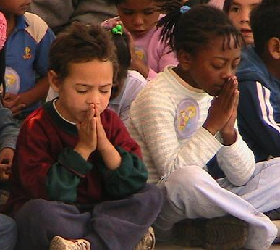
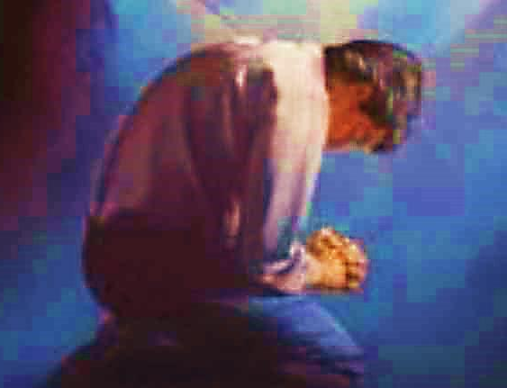
Three Important Questions
Do you want to know Jesus as your Savior right now?
Do you believe He died to save you from your sins & that He rose from the dead?
Do you believe that He is here, waiting to save you right now?

Slide 31
The Prayer of a Sinner Turning to Jesus
Dear Jesus, I know that I have sinned against You and that my sins separate me from You.
I am truly sorry.
Right now, I turn away from my sinful past .
Please forgive me, and help me to keep from sin.
I believe You died for my sins.
I Believe You rose from the dead, you are alive, and you hear this prayer from my heart.
I invite You Jesus to be both my Savior and the Lord of my life.
I want You to rule my life from now on.

Slide 32
“But some people did accept him. They believed in him, and he gave them the right to become children of God.”
John 1:12

Slide 34
“If you openly say, ‘Jesus is Lord’ and believe in your heart that God raised him from death, you will be saved.”
Rom. 10:9
What did you learn today?
What about the door of the sheep?
What have you been thinking about God lately?
What do you want to tell others about Jesus?

Slide 35
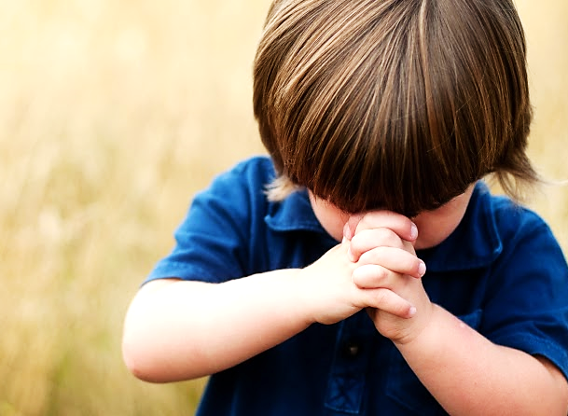
Let’s Close in Prayer

Slide 36
Note: After you download the slideshow, you may also need to download some videos from YouTube & add them into this PowerPoint. This tool can help you: Free YouTube Download
We present these messages in outdoor venues using the SonShineTent. Watch the video of our service that goes with this message, click here: http://campaignkerusso.org/?p= 11024
We would love to know more about the people who download our lessons & sermons. We invite you to email us & let us know where & how you use them.
info@campaignkerusso.org

